Slide 1


NIGHTo
ABDUL
KALAM
When less is more
APJ
By Hemendra
Missile Man Of India

Slide 2
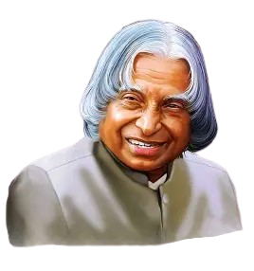
Backstory
ABDUL
KALAM
Avul Pakir Jainulabdeen Abdul Kalam 15 October 1931 – 27 July 2015) was an Indian aerospace scientist and statesman who served as the president of India from 2002 to 2007.Kalam studied physics and aroespace engineering. He spent the next four decades as a scientist and science administrator, mainly at the Defence Research and Development Organisation (DRDO) and Indian Space Research Organisation (ISRO) and was intimately involved in India's civilian space programme and military missile devlopment efforts. He was known as the "Missile Man of India" for his work on the development of ballistic missile and launch vehicle technology.
APJ

Slide 3
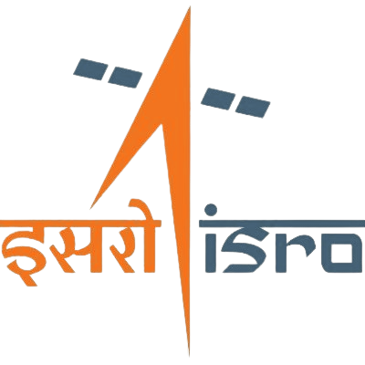
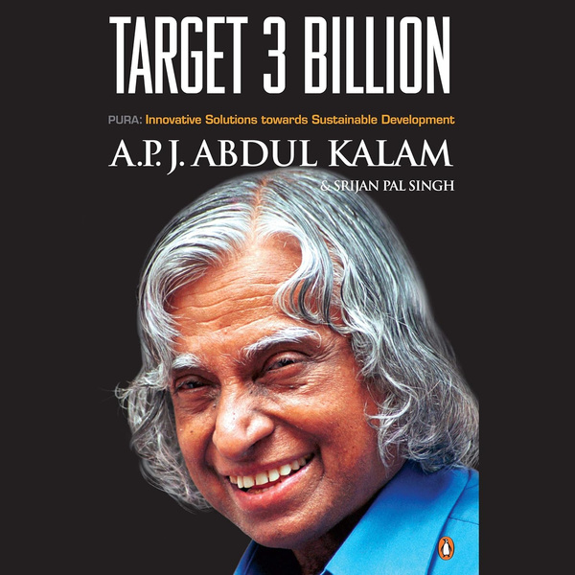
Local
ABDUL
KALAM
Kalam conceptualized and advocated for the PURA (Provision of Urban Amenities in Rural Areas scheme), a strategy for rural development that aimed to bridge the urban-rural divide by providing urban infrastructure and services in rural areas. He reportedly donated his savings to a trust related to this cause.
APJ

Slide 4
National
ABDUL
KALAM
As project director at the Indian Space Research Organisation (ISRO), he led the development of India's first indigenous satellite launch vehicle, which successfully deployed the Rohini satellite in 1980, making India a space-faring nation.
APJ

Slide 5

Global
Dr. Kalam envisioned India's sustainable future through actionable environmentalism and energy innovation. He proposed a robust blend of renewable sources—solar, wind, tidal, geothermal, and bio-fuels—alongside reducing transmission losses and generating power from municipal waste. He championed tree plantation and a "Clean Earth" movement, emphasizing that true innovation lies in daring to think differently and transforming dreams into actions that serve humanity.
Notes:
Renewable Energy Mix: Dr. Kalam proposed a robust blend of renewable sources, including solar power, wind energy, tidal, geothermal, and bio-fuels, to secure India's energy future.
Energy Efficiency & Waste Management: He advocated for reducing power transmission and distribution losses and championed the use of municipal waste for
energy generation.
Dr. Kalam envisioned India's sustainable future through actionable environmentalism and energy innovation. He proposed a robust blend of renewable sources—solar, wind, tidal, geothermal, and bio-fuels—alongside reducing transmission losses and generating power from municipal waste. He championed tree plantation and a "Clean Earth" movement, emphasizing that true innovation lies in daring to think differently and transforming dreams into actions that serve humani
Tree Plantation Drive: He believed in the power of nature, urging citizens to "plant a tree today for a better tomorrow" to balance the ecosystem.
Actionable Environmentalism: Dr. Kalam advocated for a "Clean Earth" movement, which involved maintaining clean homes, streets, and proper waste management.
Action-Oriented Dreams: Kalam emphasized that innovation comes from daring to think differently and transforming dreams into actions that serve humanity.

Slide 6
Awards
1997 – Indira Gandhi Award for National Integration
1998 – Veer Savarkar Award
2000 – Ramanujan Award
2007 – King Charles II Medal (Royal Society, UK
2007 – Hoover Medal (ASME Foundation, USA)
2008 – Doctor of Science (Honoris Causa) – Aligarh Muslim University
2009 – Honorary Doctorate – Oakland University, USA
2011 – IEEE Honorary Membership
2012 – Doctor of Law (Honoris Causa) – Simon Fraser University, Canada

Slide 7


Problems-Solution-Impact
Local
Problem
In the early 2000s, rural areas in India—particularly in states like Tamil Nadu and Maharashtra—had limited access to primary healthcare, especially for non-communicable diseases.
Solution
After his presidency, Dr. Kalam collaborated with healthcare organizations to launch the Providing Urban Amenities to Rural Areas (PURA) model. One notable initiative was working with Rameswaram’s local communities to establish a telemedicine network connecting rural clinics to specialty hospitals in cities.
Impact
Enabled remote diagnosis for villagers in his hometown region
Created a replicable model for rural healthcare connectivity
Inspired programs like Kalam Vision India Foundation to continue similar grassroots healthcare projects

Slide 8

Problems-Solution-Impact
National
Problem
In the 1980s, India faced a critical missile technology gap with limited indigenous capabilities. National security was vulnerable, and dependence on foreign arms was high.
Solution
Dr. Kalam spearheaded the Integrated Guided Missile Development Programme (IGMDP), leading to the development of:
Prithvi (tactical surface-to-surface missile)
Agni (strategic ballistic missile)
Akash, Trishul, and Nag missiles
Impact
India achieved self-reliance in missile technology
Strengthened national defense capabilities
Earned India the recognition of a nuclear-capable nation (Pokhran-II, 1998, where he played a key scientific role)

Slide 9


Problems-Solution-Impact
Global
Problem
In the 1960s–80s, developing nations like India faced restricted access to advanced space technology from developed countries. Launch vehicles and satellite technology were heavily controlled, limiting India's ability to build self-reliant space programs.
Solution
As the Project Director of India's first indigenous Satellite Launch Vehicle (SLV-3) at ISRO, Dr. Kalam led the team that successfully launched Rohini satellite into orbit in 1980. This demonstrated India's self-reliance in space technology and opened doors for international collaboration with organizations like NASA and Soviet space program.
Impact
India became one of the few nations with indigenous launch capability
Paved the way for ISRO's commercial arm, Antrix, offering launch services globally
Established India as a trusted partner in international space missions (e.g., Chandrayaan, Mangalyaan)

Slide 10
Questionnaire
Kalam’s full name is ______.
→ Avul Pakir Jainulabdeen Abdul Kalam
He was the ______ President of India.
→ 11th
His birthday, October 15, is celebrated as ______ in India.
→ World Students’ Day
Kalam joined ISRO in the year ______.
→ 1969
Kalam becomes President in which year?
→ 2002
India’s first satellite launch (SLV-3) in which year?
→ 1980

Slide 11
Questionnaire
Kalam’s full name is ______.
→ Avul Pakir Jainulabdeen Abdul Kalam
He was the ______ President of India.
→ 11th
His birthday, October 15, is celebrated as ______ in India.
→ World Students’ Day
Kalam joined ISRO in the year ______.
→ 1969
Kalam becomes President in which year?
→ 2002
India’s first satellite launch (SLV-3)
→ 1980

Slide 12
QUOTES
“Dream, dream, dream. Dreams transform into thoughts, and thoughts result in action.”
“You have to dream before your dreams can come true.”
“Teaching is a very noble profession that shapes the character, caliber, and future of an individual.”
“If you want to shine like a sun, first burn like a sun.”
APJ Abdul Kalam

Slide 13



Credits
Google
Deepseek
Brandfetch
Freepik

Slide 14
Thank you for listening

